Slide 1
Bullying
What is it?
What can you do about it?

Slide 2
You Tube Video Links
Sticks & Stones http://www.youtube.com/watch?v=pt6vuJj6ySs&feature=related
Words Hurt http://www.youtube.com/watch?v=1j6YA03hm4k&feature=related

Slide 3
What is bullying?
"Bullying" (per IC 20-33-8-.2) means overt, unwanted, repeated acts or gestures, including verbal or written communications or images transmitted in any manner (including digitally or electronically), physical acts committed, aggression, or any other behaviors, that are committed by a student or group of students against another student with the intent to harass, ridicule, humiliate, intimidate, or harm the other targeted student and create for the targeted student an objectively hostile school environment that:

Slide 4
Bullying Definition Continued
places the targeted student in reasonable fear of harm to the targeted student's person or property;
has a substantially detrimental effect on the targeted student's physical or mental health;
has the effect of substantially interfering with the targeted student's academic performance; or
has the effect of substantially interfering with the targeted student's ability to participate in or benefit from the services, activities, and privileges provided by the school.

Slide 5
Bullying Definition Continued
Bullying fosters a climate of fear and disrespect that can seriously impair the physical and psychological health of its victims and create conditions that negatively affect learning. Bullying includes unwanted, aggressive behavior that involves a real or perceived power imbalance. The behavior is repeated, or has the potential to be repeated, over time. The imbalance of power involves the use of physical strength, or popularity to access embarrassing information to control or harm others.

Slide 6
Teasing vs Bullying
Teasing
  Everyone is involved and getting an equal share of the teasing (not ganging up on one person)
  Not making fun of someone’s disabilities, ethnicity, faith, or other characteristics that are out of the person’s control
  Not meant to harm, if asked to stop they would
  Done by friends (no imbalance of power)

Slide 7
Who Bullies and why?
You can’t tell who is a bully by what they look like.
- Can be big/small, rich/poor, popular/unpopular
Reasons kids bully
  Low self-esteem
  Makes them feel “safe” if they bully others
  Increase popularity
  Copy behaviors they see from others
  They have been bullied themselves
  Jealousy
  To feel better about themselves

Slide 8
Effects on Victims of bullies…..
The effects can last a long time. Sometimes victim believes what bully says about them.
  Unwilling to attend school
  Afraid of being alone in hall / bathroom
  Give up studying/ paying attention in class
  Nightmares, crying, outbursts, & eating disorders
  Stress related head and body aches
  Reluctant to speak out
  Bruises

Slide 9
Effects of bullying on bullies….
Frequent fighting
Stealing or damaging property
Smoking &/or drinking
Truancy &/or dropping out of school
Bad grades
Office referrals, ISS, OSS, Expulsion

Slide 10
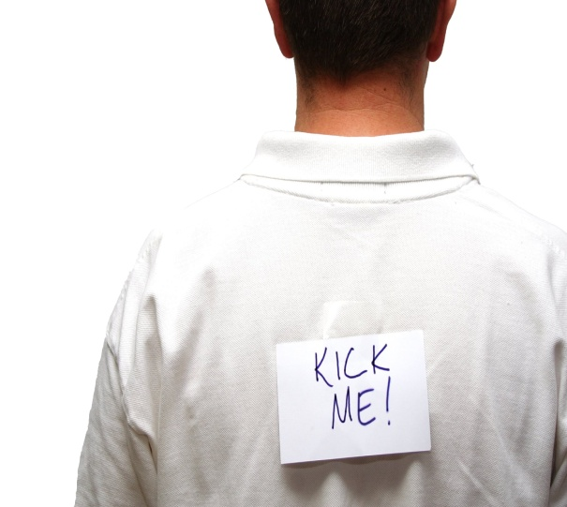
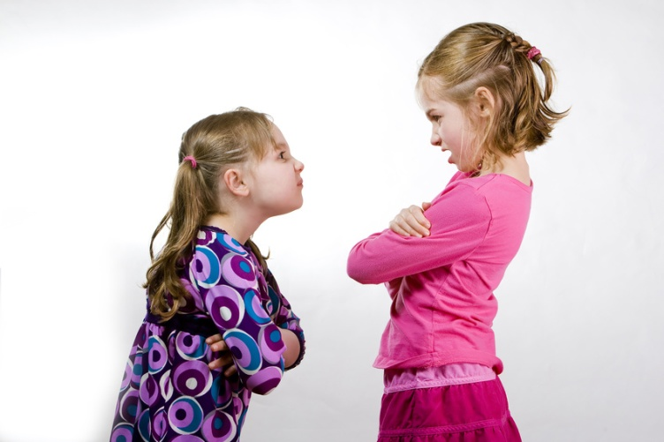
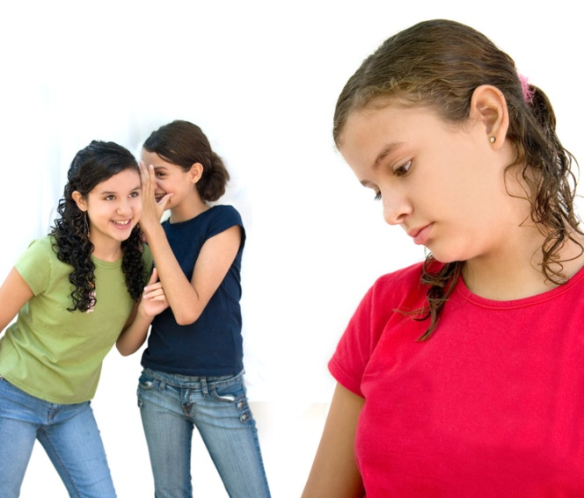
Types of Bullying
Physical
Verbal
Social / Relational
Electronic / Written Communication

Slide 11
Physical Bullying
involves hurting a person’s body or possessions. It includes hitting/ kicking/ punching, spitting, tripping or pushing, taking or breaking someone’s things, and making mean or rude hand gestures.

Slide 12
Verbal Bullying
involves saying mean things. It can include teasing, name-calling, inappropriate sexual comments, taunting, or threatening to cause harm.

Slide 13
Social / Relational Bullying
involves hurting someone’s reputation or relationships. Social bullying involves telling other children not to be friends with someone, leaving someone out on purpose, spreading rumors about someone, or embarrassing someone in public.

Slide 14
Electronic/Written Communication
involves cyber-bullying, collective or group note writing, any bullying undertaken through the use of electronic devices (computer, cell phones).

Slide 15

Cyberbullying
Definition
  When technology is used to bully others
  It is ILLEGAL (against the law)
Methods:
-e-mail
-instant messaging (im)
-text
- social networking sites (Facebook, etc)
-web pages
- blogs
- chat rooms

Slide 16
Cyber Bullying~ What can you do?
Don’t respond online
Block the Bully
Change your accounts
Record the attack
Talk to a trusted adult
Report it to your service provider
Report it to a school representative (teacher, principal, counselor)
Unplug & go offline

Slide 17
Cyber Bullying Facts
Sometimes called “Social Terrorism by Technology”
89% of middle school students report being cyber bullied
Girls are more likely to be bullied online than boys

Slide 18


Three Main People Involved…
“TARGET” –Someone who is the focus of mistreatment
“PERPETRATOR” –
Someone who says or does something against another person
“BYSTANDER”-
Someone who sees something happening and does not say or do anything

Slide 19
Sometimes involved…
“Upstander” –Someone who speaks out on behalf on someone else.

Slide 20

How You Can Help Someone Who Is Bullied…
Peers are present 85%of the time when name-calling and bullying occur!
Assess the potential safety risks if you take action right away – Get help if you don’t feel safe. Always consider the impact on the targeted person-embarrassment or safety

Slide 21
How You Can Help Someone Who Is Bullied…
Stop the Behavior Immediately
Assess the needs of the person being targeted – determine their feelings and ask what you can do to help – be an “Upstander”

Slide 22
How You Can Help Someone Who Is Bullied…
Ask Questions that Cause Perpetrators to Consider their Actions –
“I don’t understand why you said that.”
“That was really mean. Why did you say that?”
Communicate the impact of the behavior on you by Sharing Your Feelings –
“I’d appreciate it if you didn’t say that word
because I think it is offensive.”

Slide 23
How You Can Help Someone Who Is Bullied…
Maybe you are not ready to step in and stand up for someone else…..
There are still things you can do!!

Slide 24
From Being a Bystander to “Upstander”
Be a friend. Commit to providing support to the targeted person after the incident.
Don’t laugh at the jokes and comments being made by the person doing the bullying.
Don’t join in. Walk away. If possible, take the targeted person with you.
Distract the Bully.
Report any Bullying you see.

Slide 25
How Should Victims Deal With A Bully?
Ignore them!
  Pretend you didn’t hear them
  Don’t show them that you are upset.
Tell them to stop
Stick together with your friends.
Tell a trusted adult!

Slide 26
S.T.A.N.D.
Show good character every day.
Treat others the way I want to be treated.
Always report bullying to an adult.
Never bully others or stand by and watch bullying.
Do my best to help anyone who is bullied.

